Slide 1
Chapter 8: Main Memory

Slide 2
Chapter 8: Memory Management
Background
Swapping
Contiguous Memory Allocation
Paging
Structure of the Page Table
Segmentation
Example: The Intel Pentium

Slide 3
Objectives
To provide a detailed description of various ways of organizing memory hardware
To discuss various memory-management techniques, including paging and segmentation
To provide a detailed description of the Intel Pentium, which supports both pure segmentation and segmentation with paging

Slide 4
8.1 Background
8.1.1 Basic Hardware
Program must be brought (from disk) into memory and placed within a process for it to be run
Main memory and registers are only storage CPU can access directly
Register access in one CPU clock (or less)
Main memory can take many cycles
Cache sits between main memory and CPU registers
Protection of memory required to ensure correct operation

Slide 5
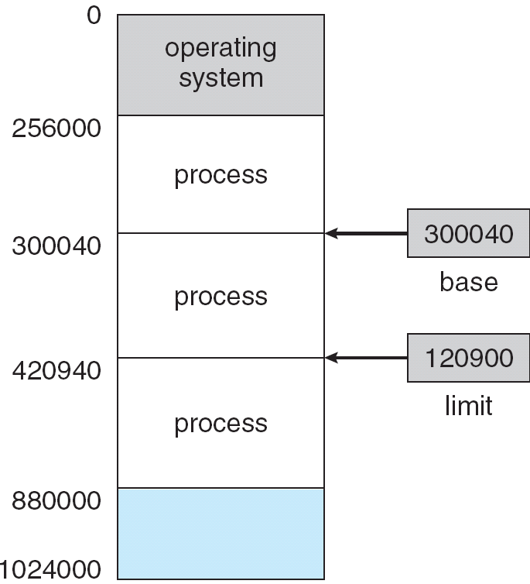
Base and Limit Registers
A pair of base and limit registers define the logical address space

Slide 6

HW address protection with base and limit registers
Physical

Slide 7
8.1.2 Address Binding
User programs go through several steps before being run.
(What are they?)

Slide 8

Multistep Processing of a User Program

Slide 9
User programs go through several steps before being run
一个用户程序的运行需要经历以下几个步骤:
  编写源程序（Source code）
  编译 （compiler → object module）
  链接 （Link）
  装入 （loading）
  执行（running）

Slide 10
Discussion：一个关键问题
各阶段地址的表示及转换问题
  源程序中如何表示？
  编译、连接时如何表示？
  运行时如何表示？
  见8.1.3，引出几个地址及相关地址空间的概念
如果编译、连接时使用的地址与运行时使用的地址是统一的，存在什么问题？（见8.1.2中编译时完成地址映射）
  如果不统一，需要进行Address Binding（地址映射，地址变换、重定位，地址绑定）：
  如何进行地址变换？（依据具体的内存管理方案）
  何时进行地址变换？（8.1.2，下页）

Slide 11
Binding of Instructions and Data to Memory
Address binding of instructions and data to memory addresses can happen at three different stages
  Compile time: If memory location known a priori, absolute code can be generated; must recompile code if starting location changes
  Load time: Must generate relocatable code if memory location is not known at compile time
  Execution time: Binding delayed until run time if the process can be moved during its execution from one memory segment to another. Need hardware support for address maps (e.g., base and limit registers)

Slide 12
Binding of Instructions and Data to Memory
逻辑地址到物理地址的映射（地址变换、重定位, 地址绑定、地址）
  编译（汇编时）时完成地址映射(Compile time)
    编译（汇编时）生成物理地址
    用户需要了解内存的使用情况
    不利于程序的浮动
    不支持虚拟存储机制
    早期的系统使用
  装入时完成地址映射 (Load time)
    装入时将逻辑地址映射为物理地址
    不利于程序的浮动
    不支持虚拟存储机制
  运行时完成地址映射(Execution time)
    运行时将逻辑地址映射为物理地址 (边执行，边变换)
    需要硬件支持
    支持虚拟存储机制

Slide 13
讨论
在下述三种地址绑定方案中，程序执行时CPU给出的地址是逻辑地址还是物理地址？
也就是说，指令中的地址码部分给出的是逻辑地址还是物理地址？
  Compile time:
  Load time:
  Execution time:

Slide 14
8.1.3 Logical vs. Physical Address Space
The concept of a logical address space that is bound to a separate physical address space is central to proper memory management
  Logical address – generated by the CPU; also referred to as virtual address
  Physical address – address seen by the memory unit
Logical and physical addresses are the same in compile-time and load-time address-binding schemes;
logical (virtual) and physical addresses differ in execution-time address-binding scheme

Slide 15
Address & Address Spaces
几个空间及相关的地址
  名空间
    名地址
    使用名字（符号）表示地址
  相对空间、逻辑空间、虚空间(logical address space )
    相对地址、逻辑地址、虚地址
    一般情况下，编译及动态链接时使用的地址
  绝对空间、物理空间、实空间(physical address space )
    绝对地址、物理地址、实地址
    实际运行时使用的内存地址

Slide 16
Memory-Management Unit (MMU)
Hardware device that maps virtual to physical address
In MMU scheme, the value in the relocation register is added to every address generated by a user process at the time it is sent to memory
The user program deals with logical addresses; it never sees the real physical addresses

Slide 17

Dynamic relocation using a relocation register

Slide 18
8.1.4 Loading--Dynamic Loading
一个用户程序的运行需要经历以下几个步骤
  编写源程序（Source code）
  编译 （compiler → object module）
  链接 （Link）
  装入 （加载，loading）
    绝对装入方式
      运行前装入所有模块
      装入时费时，浪费内存；但管理简单，运行时速度快
    动态运行时装入 (Dynamic Loading)
      运行时可只装入主控模块；
      其它模块被调用时再装入；
        提高了内存的利用率，只有需要的模块才被装入；
      管理复杂，运行时速度降低；
  执行（run）

Slide 19
Dynamic Loading
Routine is not loaded until it is called
Better memory-space utilization; unused routine is never loaded
Useful when large amounts of code are needed to handle infrequently occurring cases
No special support from the operating system is required implemented through program design

Slide 20
8.1.5 Link (Dynamic Linking and Shared Libraries)
一个用户程序的运行需要经历以下几个步骤：
  编写源程序（Source code）
  编译 （compiler → object module）
  链接 （Link）
    静态链接 （.lib）
      运行之前完成链接，将所有的程序模块链接起来，形成一个可执行文件，运行时直接装入内存；
      链接及装入过程费时，有些用不到的模块不需要链接及装入；
      不便于模块的升级；
      运行速度快；
    动态链接 （.DLL）
      运行时仅链接需要的模块；
      运行调用时进行链接；
      减少了链接需要的时间；
      节省内存空间；
      便于模块的升级、共享；
  装入 （加载，loading）
  执行（run）

Slide 21
Dynamic Linking and Shared Libraries
Linking postponed until execution time
Small piece of code, stub, used to locate the appropriate memory-resident library routine
Stub replaces itself with the address of the routine, and executes the routine
Operating system needed to check if routine is in processes’ memory address
Dynamic linking is particularly useful for libraries
System also known as shared libraries

Slide 22
8.2 Swapping
A process can be swapped temporarily out of memory to a backing store, and then brought back into memory for continued execution
Backing store – fast disk large enough to accommodate copies of all memory images for all users; must provide direct access to these memory images
Roll out, roll in – swapping variant used for priority-based scheduling algorithms; lower-priority process is swapped out so higher-priority process can be loaded and executed
Major part of swap time is transfer time; total transfer time is directly proportional to the amount of memory swapped
Modified versions of swapping are found on many systems (i.e., UNIX, Linux, and Windows)
System maintains a ready queue of ready-to-run processes which have memory images on disk

Slide 23

Schematic View of Swapping

Slide 24
操作系统对对换区的管理
追求速度，但一般文件的管理还追求空间的利用率
Windows 95/98
  Swap (连续区域)
Windows NT/Windows XP/win7/win8
  Pagefile.sys （区域可以不连续，但最好连续）
UNIX及Linux
  一般采用独立磁盘分区作为对换区

Slide 25
本章几种具体的内存管理方案的学习要点
存贮器管理系统主要关注的几个问题：
  逻辑地址空间与物理地址空间的管理方法
    根据不同的内存管理方式，使用不同的管理方法
      分区管理、页式管理、段式管理、段页式管理等
  逻辑地址到物理地址的映射方法（地址变换、重定位、地址绑定）（Address Mapping）
  存贮保护机制 （Protection）
    根据不同的内存管理方式，使用不同的保护机制；
  内存共享方法 （sharing）
    不同的内存管理方式，有不同的共享方法
  零头，碎片（fragmentation）

Slide 26
8.3 Contiguous Memory Allocation
Main memory usually into two partitions:
  Resident operating system, usually held in low memory with interrupt vector
  User processes then held in high memory
    Single-partition allocation
    Multiple- partition allocation
Relocation registers used to protect user processes from each other, and from changing operating-system code and data
  Base register contains value of smallest physical address
  Limit register contains range of logical addresses – each logical address must be less than the limit register
  MMU maps logical address dynamically
请注意课件内容与教材内容的顺序不一致（更条理、清晰）

Slide 27
Contiguous Allocation - Single-partition allocation
基本思想
  用户区中只有一个分区，每个时刻只能运行一道程序；
  如：DOS
Address mapping and Memory protection
  Relocation-register scheme used to protect user processes from each other, and from changing operating-system code and data.
  Relocation register contains value of smallest physical address; limit register contains range of logical addresses – each logical address must be less than the limit register.

Slide 28
Contiguous Allocation－Multiple- partition allocation
将用户区划分成多个分区，每个分区每个时刻运行一道程序
支持多道程序设计技术
两种分区管理技术
  静态分区管理
  动态分区管理

Slide 29
Contiguous Allocation－固定分区分配
系统初始化时，系统将内存分成多个分区
￭ 分区的数目固定
￭ 分区的大小固定
￭ 每个分区每个时刻只能运行一道程序
固定分区表
  记录各分区的位置、大小及使用情况
  用于系统对分区进行管理
内碎片（内零头）
地址映射及存储保护（使用Relocation register，limit register ）
OS
分区号 | 起始地址 | 分区大小 | 状态 | 作业
1 | … | … | 1 | p5
2 | … | … | 1 | p8
3 | … | … | 1 | p2
process 5
process 8
process 2

Slide 30
Base and Limit Registers
A pair of base and limit registers define the logical address space

Slide 31

Hardware Support for Relocation and Limit Registers
地址变换及存储保护过程

Slide 32
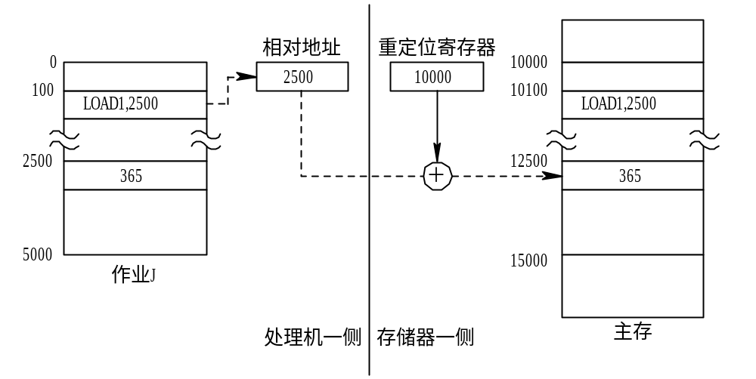
Hardware Support for Relocation
动态重定位(地址变换)示意图

Slide 33
Contiguous Allocation－动态分区管理
基本思想
  系统初始化时，只划分成一个分区
  内存“按需分配”
分区表－ －对已分配的分区进行管理
空闲分区表－ －对空闲分区进行管理
分区分配算法（ First-fit, Best-fit, Worst-fit ）
地址映射与存储保护（使用Relocation register，limit register ）
外碎片（零头外）
段式管理使用该分配方法

Slide 34
Contiguous Allocation (Cont.)
Multiple-partition allocation
  Hole – block of available memory; holes of various size are scattered throughout memory
  When a process arrives, it is allocated memory from a hole large enough to accommodate it
  Operating system maintains information about:
  a) allocated partitions b) free partitions (hole)
OS
OS
OS
OS
process 5
process 5
process 5
process 5
process 9
process 9
process 8
process 10
process 2
process 2
process 2
process 2

Slide 35
Base and Limit Registers
A pair of base and limit registers define the logical address space

Slide 36
Hardware Support for Relocation and Limit Registers
地址变换及存储保护过程

Slide 37
Hardware Support for Relocation
动态重定位(地址变换)示意图

Slide 38
Dynamic Storage-Allocation Problem
How to satisfy a request of size n from a list of free holes
Best-fit: Allocate the smallest hole that is big enough; must search entire list, unless ordered by size
  The holes is sorted according to their size;
  Produces the smallest leftover hole
First-fit: Allocate the first hole that is big enough
  The holes is sorted according to their addresses;
Worst-fit: Allocate the largest hole; must also search entire list
  The holes is sorted according to their size
  Produces the largest leftover hole
First-fit and best-fit better than worst-fit in terms of speed and storage utilization

Slide 39
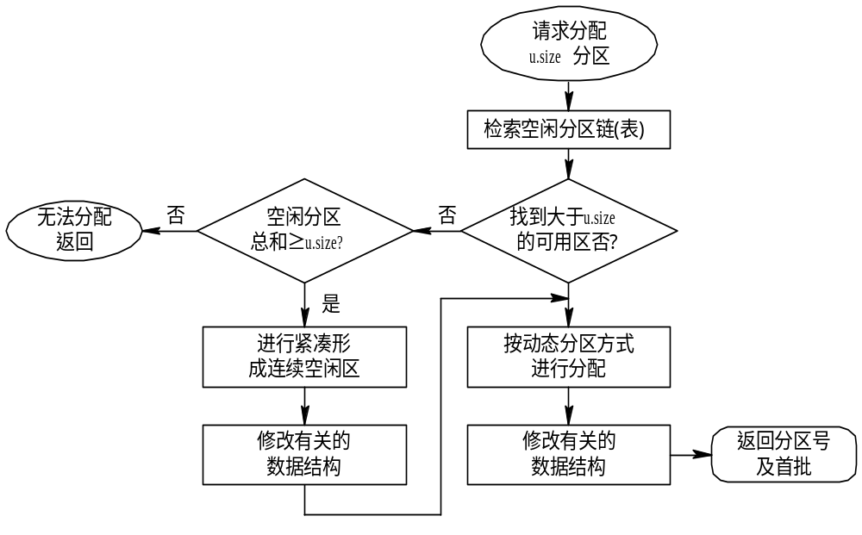
分区分配算法
分区分配算法流程图

Slide 40
分区分配算法例题
有一采用分区存储管理的OS，用户区主存在512KB，空闲块链入空块表，分配时截取空块的前半部分（小地址部分）。初始时全部空闲。在执行了如下申请、释放操作序列后：
request(300kB),request(100kB),release(300KB),request(150KB),request(50KB),reg(90KB)
1、采用首次（最先）适配，空块表中有哪些空块（指出大小及始址）
2、采用最佳适配，空块表中有哪些空块（指出大小及始址）
3、若随后又要申请80KB，针对上述两种情况，会产生什么后果？

Slide 41
采用首次适应算法
块1：首址290KB，长度10KB
块2：首址400KB，长度112KB
采用最佳适应算法
块1：首址240KB，长度60KB
块2：首址450KB，长度62KB
随后又要申请80KB
  对于首次适应算法，分配成功；
  对于最佳适应算法，分配失败；

Slide 42
8.3.3 Fragmentation
External Fragmentation – total memory space exists to satisfy a request, but it is not contiguous
Internal Fragmentation – allocated memory may be slightly larger than requested memory; this size difference is memory internal to a partition, but not being used
Reduce external fragmentation by compaction
  Shuffle memory contents to place all free memory together in one large block
  Compaction is possible only if relocation is dynamic, and is done at execution time
  I/O problem
    Latch job in memory while it is involved in I/O
    Do I/O only into OS buffers

Slide 43
分区式存储管理的特点
作业或进程存放在一段连续的内存区域
管理简单
对于比较大的作业，有时找到一个足够大的连续区域比较困难

Slide 45
8.4 Paging
Problems of Contiguous Allocation
  碎片问题
    External Fragmentation
    Internal Fragmentation
  查找大的连续的区域困难
  当对换时磁盘的对换区(backing store)也面临着同样的问题（查找足够的空间对换、碎片等）
Solution
  Noncontiguous allocation
早期的系统主要采用硬件实现，现在一般采用软硬结合

Slide 46
8.4.1 Basic Method
Logical address space of a process can be noncontiguous; process is allocated physical memory whenever the latter is available
Divide physical memory into fixed-sized blocks called frames (size is power of 2, between 512 bytes and 8,192 bytes)
Divide logical memory into blocks of same size called pages
Keep track of all free frames
To run a program of size n pages, need to find n free frames and load program
Set up a page table to translate logical to physical addresses
Internal fragmentation

Slide 47
Paging-- Basic Method
基本思想
  内存分块（页框，frame），作业分页（page），页与页框大小相等
  内存分配以页为单位
  一个作业在内存中的各页面可以分配不相邻的页框，但一个页面在内存中是连续的（在一个页框中）
  逻辑地址的格式：页号，页内偏移量
  页表－页号与页框号的对应关系
  内碎片
  需要记录块（页框）的使用情况（已分配的、空闲的）－例如位示图
  地址变换机构（过程）
存储保护
  页号越界检查（或设置相应的标志位（有效位））
  共享页的访问权限
页面共享
  通过页表实现

Slide 48
Address Translation Scheme
Address generated by CPU is divided into:
  Page number (p) – used as an index into a page table which contains base address of each page in physical memory
  Page offset (d) – combined with base address to define the physical memory address that is sent to the memory unit
  For given logical address space 2^{m} and page size 2^{n}
page number
page offset
p
d
m - n
n

Slide 49

Paging Model of Logical and Physical Memory
Fig. 8.8 Paging Model of Logical and Physical Memory

Slide 50

Paging Example
Fig. 8.9 Paging example for a 32-byte memory and 4-byte pages

Slide 51

Free Frames
Fig. 8.10
Before allocation
After allocation

Slide 52
Discussion: Logical Address Space
The logical address space is still a linear address space and, the physical addresses are one-dimensional physical addresses）
Suppose we have a system with 16 bytes logical address space, page size is 4 bytes, then how to divide the logical address into Page number and Page offset ?
When the page size is 8 bytes, then ….

Slide 53

Paging Example
How to divide the address generated by CPU into Page number and Page offset ?
Page size=4 bytes

Slide 54
地址的划分
考虑一个由8页且每页1K字节组成的逻辑地址空间，如果内存被划分成32块(帧)。
问：
  逻辑地址的有效位是多少？
  物理地址的有效位是多少？

Slide 55

Paging Hardware- P288
(address translation)
Fig. 8.7 Paging Hardware (address translation)

Slide 56
Example of address translation
在某个采用页式存储管理的系统中，现有J1，J2，J3共三个作业同驻内存。其中J2有四个页面，被分别装入到主存的第3，4，6，8号块中。假定页面和存储块的大小均为1024字节，主存容量为10k字节。
1、写出J2的页面映象表；
2、当J2在CPU上运行时，执行到其地址 空间第500号处遇到一条指令
MOV 2100,3100 （10进制）
请用地址变换图计算出MOV 指令中两个操作数的物理地址。

Slide 57
例题提示
将逻辑地址化分成“页号，偏移量”的形式；
方法一：将2100₁₀转化成二进制，从低位截取10位为页内偏移量（页大小为1024字节），剩余的高位为页号；
方法二：2100÷1024=2…52，即页号为2，页内偏移量为52；
查页表，2号页面在第6号块中，因此逻辑地址2100对应的物理地址为6x1024+52=6196;
3100 ÷1024＝3…28，即页号为3，页内偏移量为28；
逻辑地址3100对应的物理地址为8x1024+28=8220;
画出地址变换图；

Slide 58
Implementation of Page Table
8.4.2 Hardware Support
Page table is kept in main memory
Page-table base register (PTBR) points to the page table
Page-table length register (PRLR) indicates size of the page table
In this scheme every data/instruction access requires two memory accesses. One for the page table and one for the data/instruction.
The two memory access problem can be solved by the use of a special fast-lookup hardware cache called associative memory or translation look-aside buffers (TLBs) (相联存储器、旁路转换缓冲、页表缓冲)
Some TLBs store address-space identifiers (ASIDs) in each TLB entry – uniquely identifies each process to provide address-space protection for that process

Slide 59
Associative Memory
Content-addressed or associative memory refers to a memory organization in which the memory is accessed by its content (as opposed to an explicit address).
Thus, reference clues are "associated" with actual memory contents until a desirable match (or set of matches) is found.

Slide 60
Associative Memory
Associative memory – parallel search
Address translation (p, d)
  If p is in associative register, get frame # out
  Otherwise get frame # from page table in memory
Page #
Frame #

Slide 61

Paging Hardware With TLB
Fig. 8.11 Paging Hardware With TLB

Slide 62
Effective Access Time
Associative Lookup = ε time unit （检查快表的时间）
Assume memory cycle time is 1 microsecond
Hit ratio – percentage of times that a page number is found in the associative registers; ratio related to number of associative registers
Hit ratio = α （命中率）
Effective Access Time (EAT)
EAT = (1 + ε) α + (2 + ε)(1 – α)
= 2 + ε – α

Slide 63
例题
对于一个利用快表（TLBS）且页表存于内存的分页系统，假定CPU一次访问内存的时间为1μs，访问快表（TLBS）的时间可忽略不计。如果85％的地址映射可直接通过快表完成，那么进程完成一次内存读写的平均有效时间是多少？

Slide 64
关于页表
每个进程分别有一个页表（进程页表），在PCB中(由PCB给出)
硬件地址变换机构一个系统只有一套，其中含有正在执行的进程的有关页表的信息 （MMU）
系统的地址变换机构主要包括：
  系统页表
  Page-table base register (PTBR)
  Page-table length register (PRLR)
  以及其它地址变换机构
当调度到一个进程时，系统将其PCB中保存的页表信息装入到系统页表中，并设置相应的控制寄存器，及相应的标志位（页面存在位）；
不加特别说明，我们一般指的是系统页表

Slide 65
8.4.3 Memory Protection
检查页号是否超出了自己的地址空间所定义的范围（要访问的是否是非法页面，即非法地址）
检查对该页框的访问许可：只读、读写、只执行等；
在页表中设置相应的位表示该页框的访问许可

Slide 66
Memory Protection
Memory protection implemented by associating protection bit with each frame
Valid-invalid bit attached to each entry in the page table:
  “valid” indicates that the associated page is in the process’ logical address space, and is thus a legal page
  “invalid” indicates that the page is not in the process’ logical address space
当调度到一个进程时，系统将其PCB中保存的页表信息装入到系统页表中，并设置相应的控制寄存器，及相应的标志位（页面存在位）；

Slide 67

Valid (v) or Invalid (i) Bit In A Page Table

Slide 68
Paging Hardware（地址越界检查）
页内偏移量不需检测
是否地址越界；
1、在页表中对应每一页设置一个valid/invalid bit，用于检测页号是否越界；
2、或者将页号(P)与页表长度(PTL)比较，如果P>=PTL,则产生地址越界中断。

Slide 69
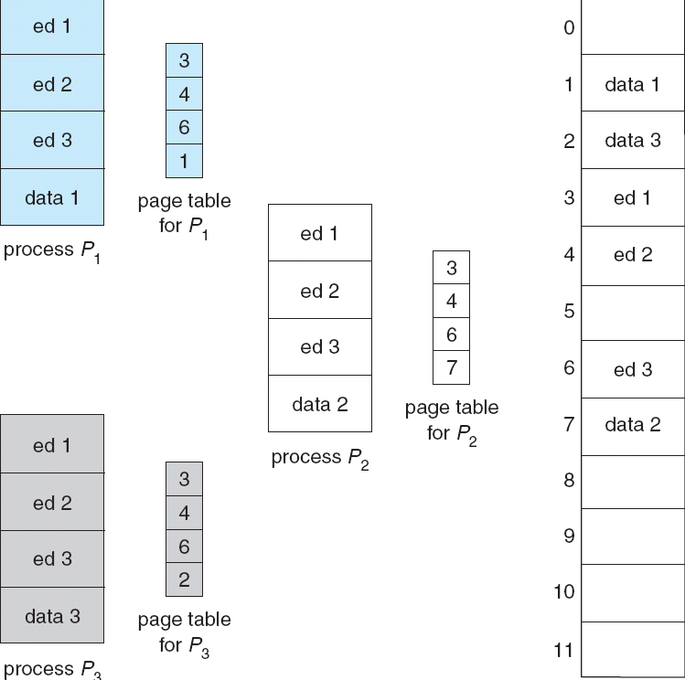
8.4.4 Shared Pages Example

Slide 70
Shared Pages
Shared code
  One copy of read-only (reentrant code，pure code) code shared among processes (i.e., text editors, compilers, window systems).
  reentrant code or pure code is non-self-modifying code, it never changes during execution.
  Shared code must appear in same location in the logical address space of all processes.（why？）
    The shared pages typically contain references to themselves.
    A conditional jump and/or a loop, for example.
Private code and data
  Each process keeps a separate copy of the code and data
  The pages for the private code and data can appear anywhere in the logical address space

Slide 71
8.5 Structure of the Page Table
Hierarchical Paging（层次页表）
Hashed Page Tables （哈希页表）
Inverted Page Tables （反置页表）

Slide 72
8.5.1 Hierarchical Page Tables
有的环境（32位机及64位机）中页表相当大，页表无需存放在内存的连续区域中；
一个页框无法容纳，需要多个页框；
将一个大的页表分解成多个较小的页表
  例如一个页框容纳一个较小的页表
Break up the logical address space into multiple page tables
A simple technique is a two-level page table
页表，以及页表的页表

Slide 73

Two-Level Page-Table Scheme

Slide 74
Two-Level Paging Example
A logical address (on 32-bit machine with 4K page size) is divided into:
  a page number consisting of 20 bits
  a page offset consisting of 12 bits
Since the page table is paged, the page number is further divided into:
  a 10-bit page number
  a 10-bit page offset
Thus, a logical address is as follows:
where p_{i} is an index into the outer page table, and p₂ is the displacement within the page of the outer page table
page number
page offset
p_{i}
p₂
d
10
10
12

Slide 75

Address-Translation Scheme

Slide 76


Three-level Paging Scheme

Slide 77
Two-Level Paging Example
某系统逻辑地址10位，页面大小为16bytes；
    页号位6，页内偏移量为4位，
假定每个页表项占用2个字节
如果不采用层次页表的思想，则页号为6位，页表大小为64项
  由于每个页表项为2字节，因此页表占用128字节，即8个物理帧；
若采用层次页表的思想，由于每个帧存放8个页表项，因此可将逻辑地址划分为（3，3，4）位
  表项数目：外层页表(8项)，每个页表(8项)，每页字节数(16个)
  这样一级页表及每个二级页表均可以在一个帧中存储
给定逻辑地址：121₁₀=0001111001₂
  若不采用层次页表，则p=7,d=9
  若采用层次页表：说明寻址过程；
  121/16=7…9, 7/16=0..7，因此逻辑地址： 0;7;9，即000,111;1001

Slide 78
地址：000,111,1001
0
…
…
7
20
…
50
0
1
2
3
4
…
0
1
2
…
7
…
0
…
…
7
30
…
4
…
0
…
…
7
200
…
500
outer page table
Page table
内存

Slide 79
地址：000,111,1001
0
…
…
7
20
…
50
0
1
2
3
4
…
0
1
2
…
7
…
0
…
…
7
30
…
4
…
0
…
…
7
200
…
500
outer page table
Page table
内存

Slide 80
地址：000,111,1001
0
…
…
7
20
…
50
0
1
2
3
4
…
50
0
1
2
…
7
…
0
…
…
7
30
…
4
…
0
…
…
7
200
…
500
outer page table
Page table
内存

Slide 81
地址：000,111,1001
0
…
…
7
20
…
50
0
1
2
3
4
…
50
逻辑地址
000,111,1001在内存的第50号页框中，因此：
逻辑地址
000,111,1001 对应的物理地址为：110010 1001
即：
(809=50*16+9)
0
1
2
3
0
…
…
7
30
…
4
…
0
…
…
7
200
…
500
outer page table
Page table
内存

Slide 82
另一个例子
分页系统，逻辑地址为32位，页的大小为16K，一个页表项占4个字节。
  （1）若采用多级页表使页表也分页存放，请说明页表的结构，应采用几级页表比较合适？逻辑地址的页号部分相应地如何划分？页内偏移占几个比特？
  （2）在不考虑缺页异常的情况下，简述逻辑地址54321（10进制）的地址转换过程。
  （3）说明操作系统和CPU在分页系统中的分工。

Slide 83
8.5.2 Hashed Page Tables
Common in address spaces > 32 bits
The virtual page number is hashed into a page table. This page table contains a chain of elements hashing to the same location.
Virtual page numbers are compared in this chain searching for a match. If a match is found, the corresponding physical frame is extracted.

Slide 84

Hashed Page Table
h(p)=h(q)

Slide 85
8.5.3 Inverted Page Table
One entry for each real page of memory
Entry consists of the virtual address of the page stored in that real memory location, with information about the process that owns that page
Decreases memory needed to store each page table, but increases time needed to search the table when a page reference occurs
Use hash table to limit the search to one — or at most a few — page-table entries

Slide 86

Inverted Page Table Architecture
依据pid与P查找页表，找到的项在页表中的位置就是页框号。
思考：为什么页表中要有pid？

Slide 88
8.6 Segmentation
8.6.1 Basic Method
分页存在的问题
  实际内存与用户所理解的内存的不一致性
  共享困难（可能将一个独立的模块划分成多个页面）
一般一个程序，由
  主程序及若干子程序、函数、过程、方法等组成
  还有若干数据结构：表、堆栈、数组、变量等
用户的观点
  程序中的每一部分是逻辑上的独立单位
  在内存中也最好按该逻辑单位进行管理
  也便于共享

Slide 89
Segmentation
Memory-management scheme that supports user view of memory
A program is a collection of segments. A segment is a logical unit such as:
main program,
procedure,
function,
method,
object,
local variables, global variables,
common block,
stack,
symbol table, arrays

Slide 90

User’s View of a Program

Slide 91
Logical View of Segmentation
1
1
4
2
3
4
2
3
user space
physical memory space

Slide 92
Segmentation
基本思想
  作业分段，内存按动态分区管理
  内存分配以段为单位
  每个段都有一个段名和长度
  一个作业在内存中可以不连续，但在一个段内是连续的
  逻辑地址的格式：段号 ，段内偏移量
  段表－段与段所在内存位置的对应关系
  外碎片
地址变换机构（过程）
存储保护
  段号、段内偏移量的越界检查，段的访问权限
段的共享
一般情况下，编译器根据程序构造段；
分段的例子

Slide 93

Example of Segmentation

Slide 94
Segmentation Architecture
Logical address consists of a two tuple:
<segment-number, offset>,
Segment table – maps two-dimensional physical addresses; each table entry has:
  base – contains the starting physical address where the segments reside in memory
  limit – specifies the length of the segment
Segment-table base register (STBR) points to the segment table’s location in memory
Segment-table length register (STLR) indicates number of segments used by a program;
segment number s is legal if s < STLR

Slide 95
Segmentation Architecture (Cont.)
Relocation.
  dynamic
  by segment table
Sharing.
  shared segments
  same segment number
Allocation.
  first fit/best fit
  external fragmentation

Slide 96
Segmentation Architecture (Cont.)
Protection
  With each entry in segment table associate:
    validation bit = 0 ⇒ illegal segment
    read/write/execute privileges
Protection bits associated with segments; code sharing occurs at segment level
Since segments vary in length, memory allocation is a dynamic storage-allocation problem

Slide 97

8.6.2 Segmentation Hardware
在段表中对应每个段设置一个valid/invalid bit，用于检测段号是否越界；
或者将段号与段表长度进行比较，以检测段号是否越界；
检测段内偏移量
是否越界；

Slide 98
Two memory accesses every data/instruction
Segment table is kept in main memory
Segment-table base register (STBR) points to the segment table
Segment -table length register (SRLR) indicates size of the segment table
In this scheme every data/instruction access requires two memory accesses. One for the segment table and one for the data/instruction.

Slide 99
地址变换及存储保护例题(P312,12)
考虑下面的段表：
段号 基地址 段长
0 219 600
1 2300 14
2 90 100
3 1327 580
4 1592 96
计算下面的逻辑地址对应的物理地址：
0,430
1,10
2,500
3,400
4,112
物理地址＝219+430=649
物理地址＝2300+10=2310
因为段内偏移量500>段长100，地址越界；
物理地址＝1327+400=1727
因为段内偏移量112>段长96，地址越界；

Slide 100
Shared Segments
Shared code
  One copy of read-only code (reentrant code，pure code) shared among processes (i.e., text editors, compilers, window systems).
  reentrant code or pure code is non-self-modifying code, it never changes during execution.
  Shared code must appear in same location in the logical address space of all processes.（why？）
    Code segments typically contain references to themselves.
    A conditional jump and/or a loop, for example.
Private code and data
  Each process keeps a separate copy of the code and data.
  The pages for the private code and data can appear anywhere in the logical address space.

Slide 101

Sharing of Segments

Slide 102
分段与分页的主要区别
页是信息的物理单位，分页是为实现离散分配方式，以消减内存的外碎片，提高内存的利用率；或者说，分页仅仅是由于系统管理的需要，而不是用户的需要；
段是信息的逻辑单位，它包含有一组其意义完整的信息。分段的目的是为了能更好地满足用户的需要；
页的大小固定且由系统决定，把逻辑地址划分为页号和页内地址两部分，是由机器硬件实现的，因为一个系统只有一种大小的页面；
段的长度不固定，决定于用户所编写的程序，通常由编译程序对源程序进行编译时，根据信息的性质来划分；
分页的作业地址空间是一维的，即单一的线性地址空间，程序员只须一个地址记忆符，即可表示一个地址；
分段的作业地址空间是二维的，程序员在标识一个地址时，既需给出段名，又需给出段内地址；

Slide 104
Segmentation with Paging – MULTICS(补充)
基本思想
  作业先分段，各段再分页，内存划分成与页相等的页框；
  每个段都有一个段名；
  内存分配以页为单位；
  每个作业有一个段表，记录段在内存的起始地址以及段长；
  每个段还对应一个页表；
  逻辑地址的格式：段号 ，段内偏移量（页号，页内偏移量）
  内碎片
地址变换机构（过程）
存储保护
  对段号、页号进行地址越界检查
段及页的共享

Slide 105
Segmentation with Paging – MULTICS
The MULTICS system solved problems of external fragmentation and lengthy search times by paging the segments.
Solution differs from pure segmentation in that the segment-table entry contains not the base address of the segment, but rather the base address of a page table for this segment.

Slide 106

MULTICS Address Translation Scheme

Slide 107
8.7 Example: The Intel Pentium
Supports both pure segmentation and segmentation with paging
CPU generates logical address
  Given to segmentation unit
    Which produces linear addresses
  Linear address given to paging unit
    Which generates physical address in main memory
    Paging units form equivalent of MMU

Slide 108
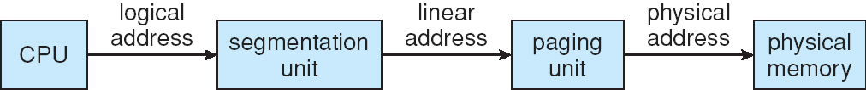

Logical to Physical Address Translation in Pentium

Slide 109

8.7.1 Intel Pentium Segmentation
selector
s
g
p
13
1
2
s: Segment number
g: the segment is in GDT or LDT
p: for Protection

Slide 110
8.7.2 Pentium Paging
A Pentium uses a two-level paging scheme in which the division of the 32-bit liner address is as follows:
page number
page offset
p_{i}
p₂
d
10
10
12

Slide 111
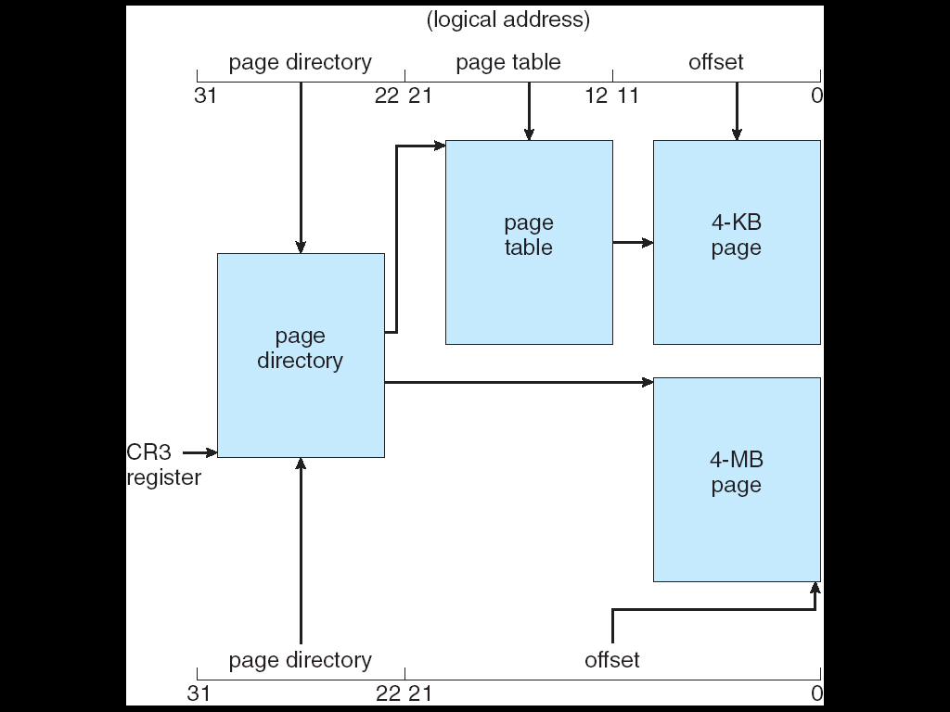
Pentium Paging Architecture

Slide 112
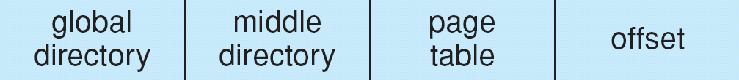
Linear Address in Linux
8.7.3 Linux on Pentium Systems
Linux has adopted a three level paging strategy that works well on both 32-bit and 64-b t architectures.
The linear address in Linux is broken into the following four parts:

Slide 113
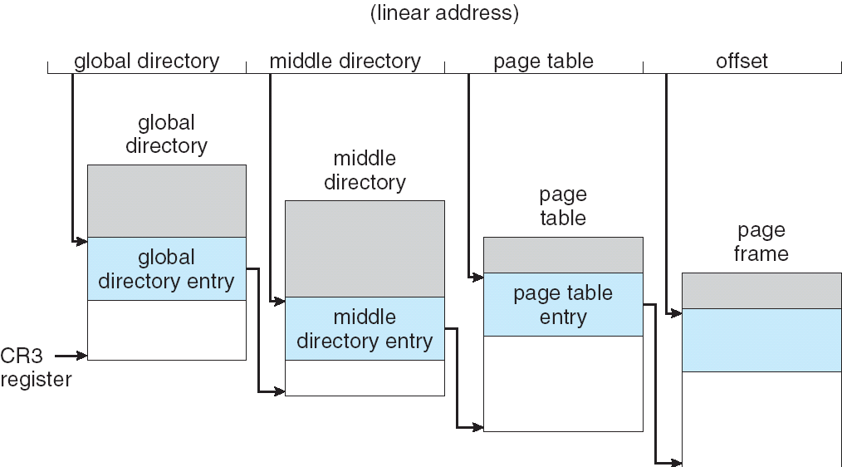
Three-level Paging in Linux

Slide 114
Homework
Page 310
1,3,4,6,9,12,13
几个地址及相应的地址空间概念；
分区管理中的几个分区算法；
Fragmentation
分页、分段管理的基本思想；
分页、分段管理的地址变换过程；
分页、分段管理的存储保护方法；
分页、分段管理的内存共享（方法、条件）
Structure of the Page Table(页表结构)

Slide 115
End of Chapter 8

